Slide 1
Data Science What is Machine Learning? A quick overview of what’s to come in this Summer Data Science Program
Adriano zambom

Slide 2
What is Machine Learning?
Machine learning is a set of statistical and computer science techniques that use data to recognize patterns and predict future outcomes.
These predictions are based on models from sample inputs (data).
This is closely related to artificial intelligence (AI)

Slide 3
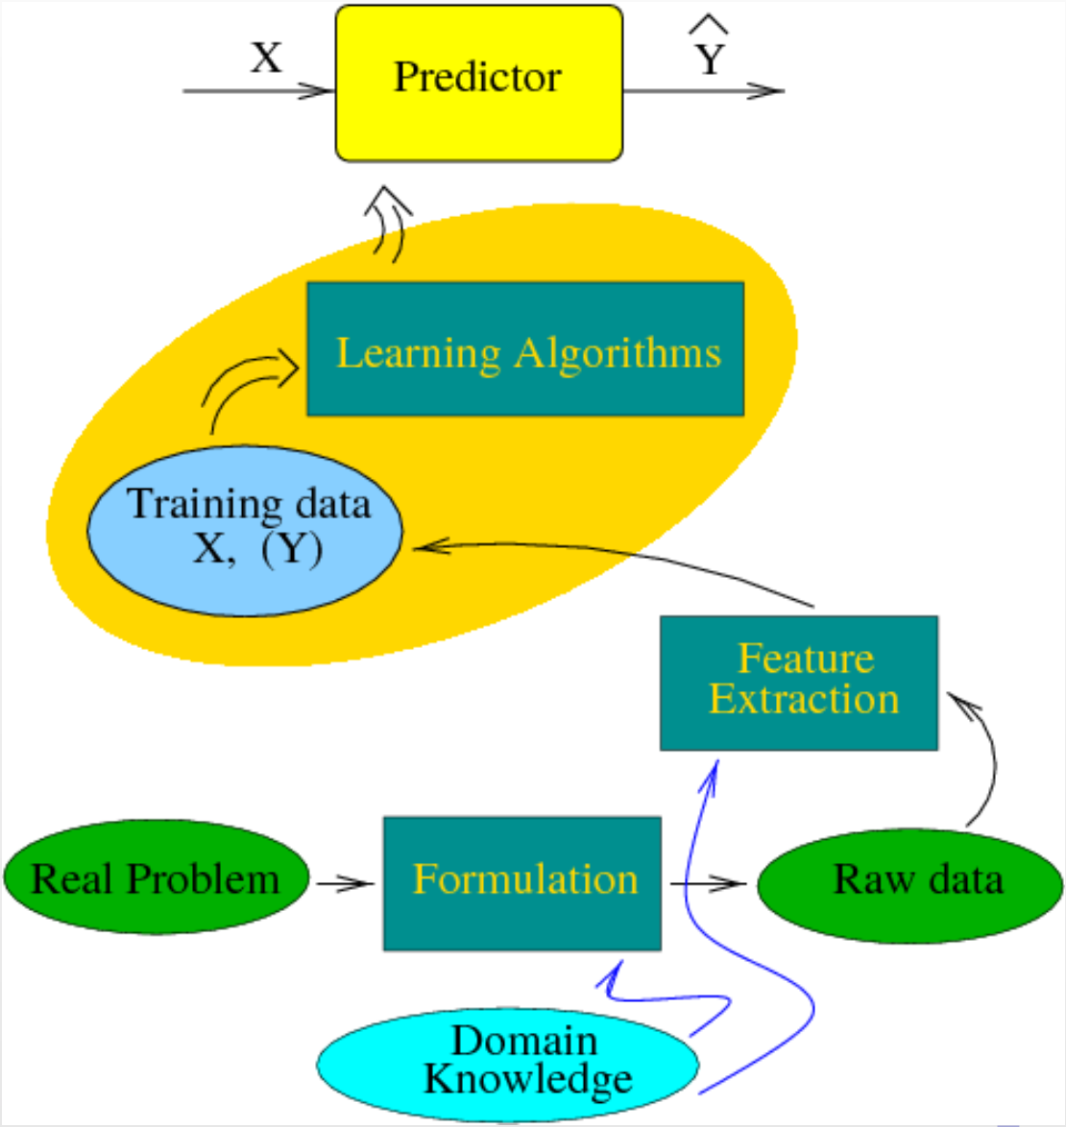
Machine Learning

Slide 4
Machine learning
Let’s focus on two aspects: Supervised vs Unsupervised Learning
Supervised Learning: Besides the data on each person (object) we also know an outcome
Can we use the data to classify according to the outcome or predict the outcome?
Unsupervised Learning: Want to learn about the structure of the data
Can people be clustered according to their characteristics?

Slide 5
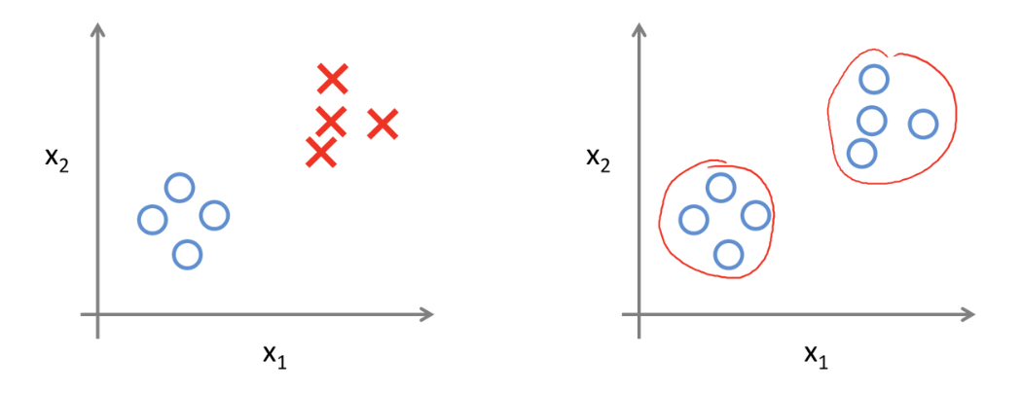
Supervised learning Unsupervised Learning
What does the data look like?
X1 | X2 | Y
2 | 4 | 1
2.8 | 5 | 1
3.2 | 2.2 | 1
4 | 4 | 1
6.8 | 6 | 2
7.1 | 6.7 | 2
7.1 | 7 | 2
9 | 6.5 | 2
X1 | X2
2 | 4
2.8 | 5
3.2 | 2.2
4 | 4
6.8 | 6
7.1 | 6.7
7.1 | 7
9 | 6.5

Slide 6
Supervised learning
Some techniques used:
logistic regression,
naive Bayes,
discriminant analysis
support vector machines,
artificial neural networks,
random forests
etc

Slide 7
Supervised Learning
Example: Email spam:
Goal: predict whether an email is a junk email, i.e., “spam”.
Raw data: text email messages.
Input X: relative frequencies of 50 of the most commonly occurring words and punctuation marks in the email message.
Training data set: 4601 email messages with email type known (supervised learning).
Email id | Email Type | Rel. Freq: “is” | Rel. Freq: “need” | Rel. Freq: “have” | Rel. Freq: “.” | …
Email 1 | Spam | 10/234 | 10/234 | 19/234 | 20/234 | …
Email 2 | Not Spam | 22/420 | 1/420 | 14/420 | 21/420 | …
Email 3 | Not Spam | 3/98 | 0/98 | 4/98 | 5/98 | …
Email 4 | Spam | 5/121 | 4/121 | 5/121 | 13/121 | …
Email 5 | Not Spam | 8/206 | 2/206 | 6/206 | 13/206 | …
… | … | … | … | … | … | …

Slide 8
Supervised Learning
Example: Handwritten digit recognition
Goal: identify single digits 0 ∼ 9 based on images.
Raw data: images that are scaled segments from five digit ZIP codes.
16 × 16 eight-bit grayscale maps
Pixel intensities range from 0 (black) to 255 (white).
Input data/Training Dataset: Images transformed into 256 dimension vectors, or feature vectors with lower dimensions. We know in our data what number the image corresponds to.
Challenge: New image comes in, what is the number?

Slide 9
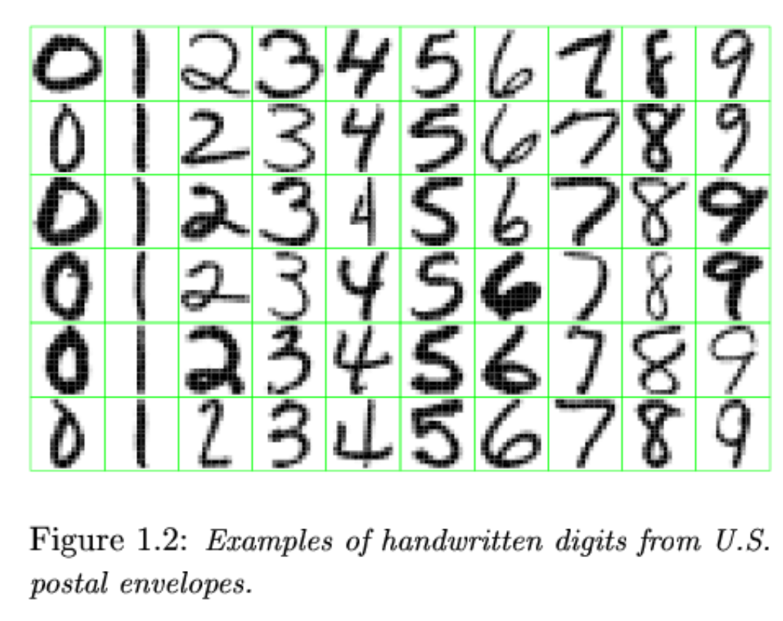
Supervised Learning
Example: Handwritten digit recognition

Slide 10
Supervised Learning
Example: Speech recognition:
Goal: identify words spoken according to speech signals
Automatic voice recognition systems used by airline companies
Automatic stock price reporting
Raw data: voice recordings from text reading (we know the text).
Challenge: A new recording comes in, can we identify what he/she said?

Slide 11
Supervised Learning
Example: DNA Expression Microarray:
Goal: identify disease or tissue types
Raw data: for each sample taken from a tissue of a particular disease type, the expression levels of a large collection of genes are measured.
Input data: cleaned-up gene expression data
Example data set: 4026 genes, 96 samples taken from 9 classes of tissues ( we know the classes)
Challenge: Given a person’s gene expression, can we say what type of tissue he/she has (cancer/no cancer)?

Slide 12
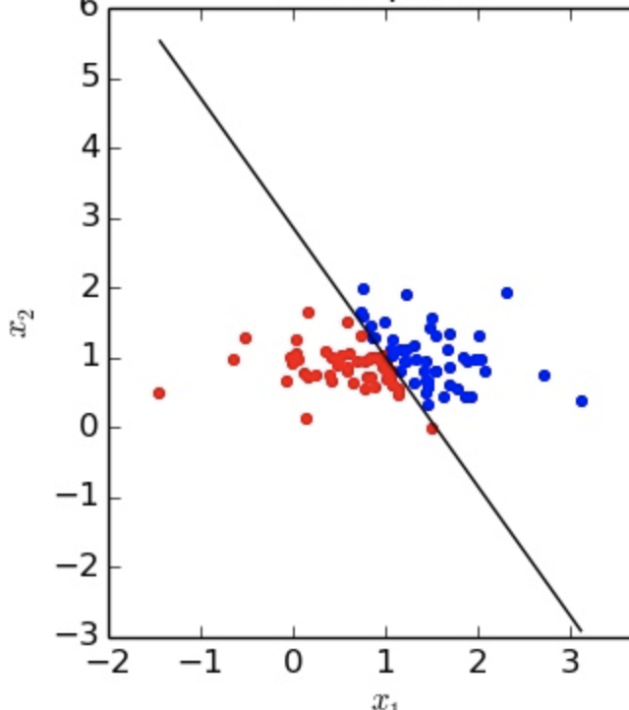
Supervised learning

Slide 13
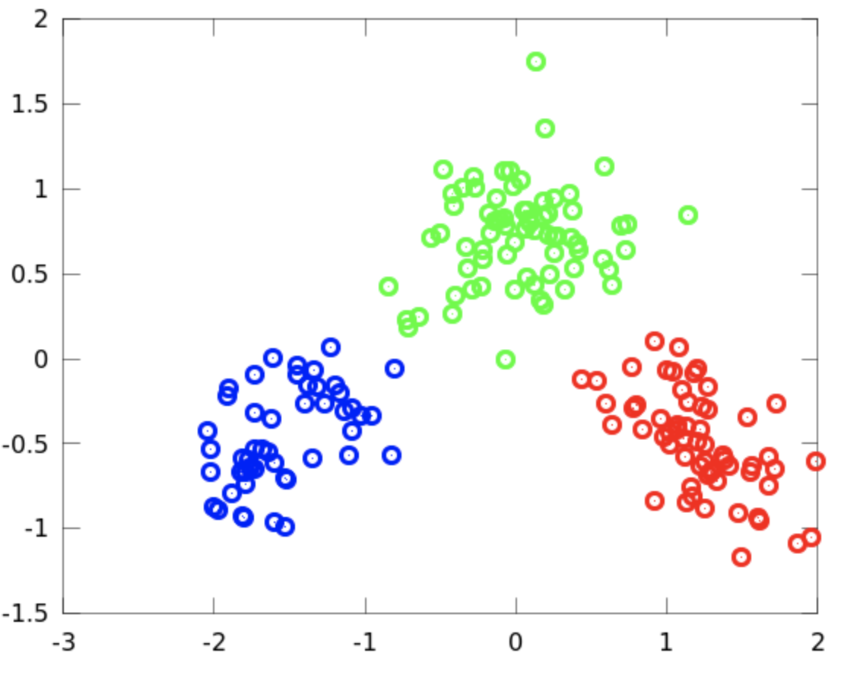
Supervised learning

Slide 14
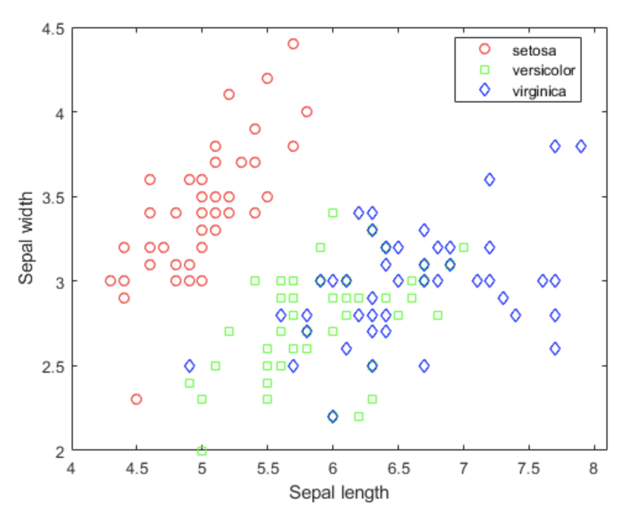
Supervised Learning
This famous (Fisher's or Anderson's) iris data set gives the measurements in centimeters of the variables sepal length
and width and petal length and width, respectively, for 50 flowers from each of 3 species of iris.
The species are Iris setosa, versicolor, and virginica.
Let’s look at this
Dataset in R

Slide 15
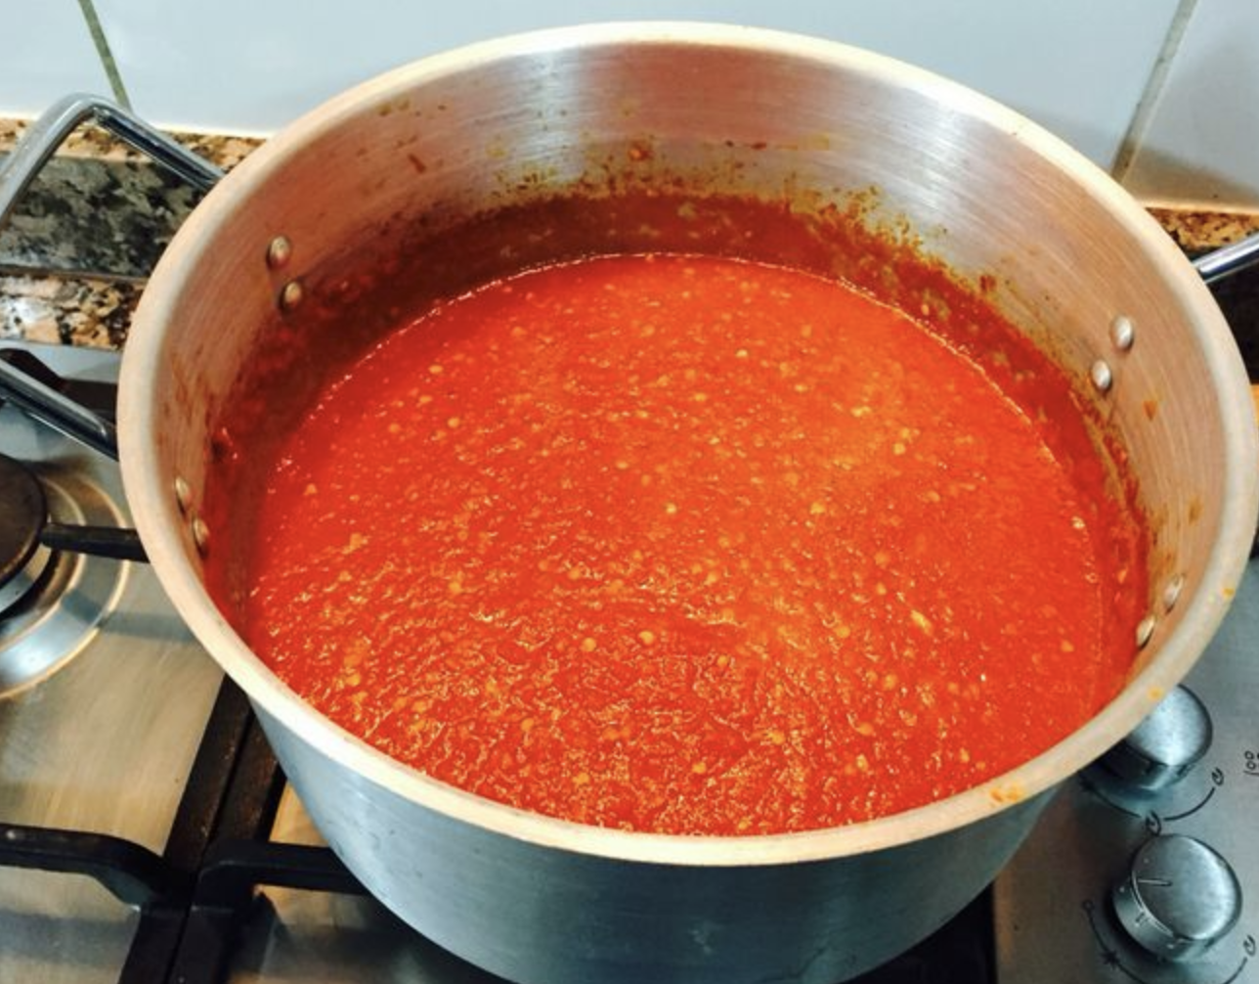
Supervised Learning
Regression: Your outcome is a continuous variable
We have the information X, and the outcome Y.
For example the outcome Y may be: cholesterol level, height, size, distance, yield, etc

Slide 16
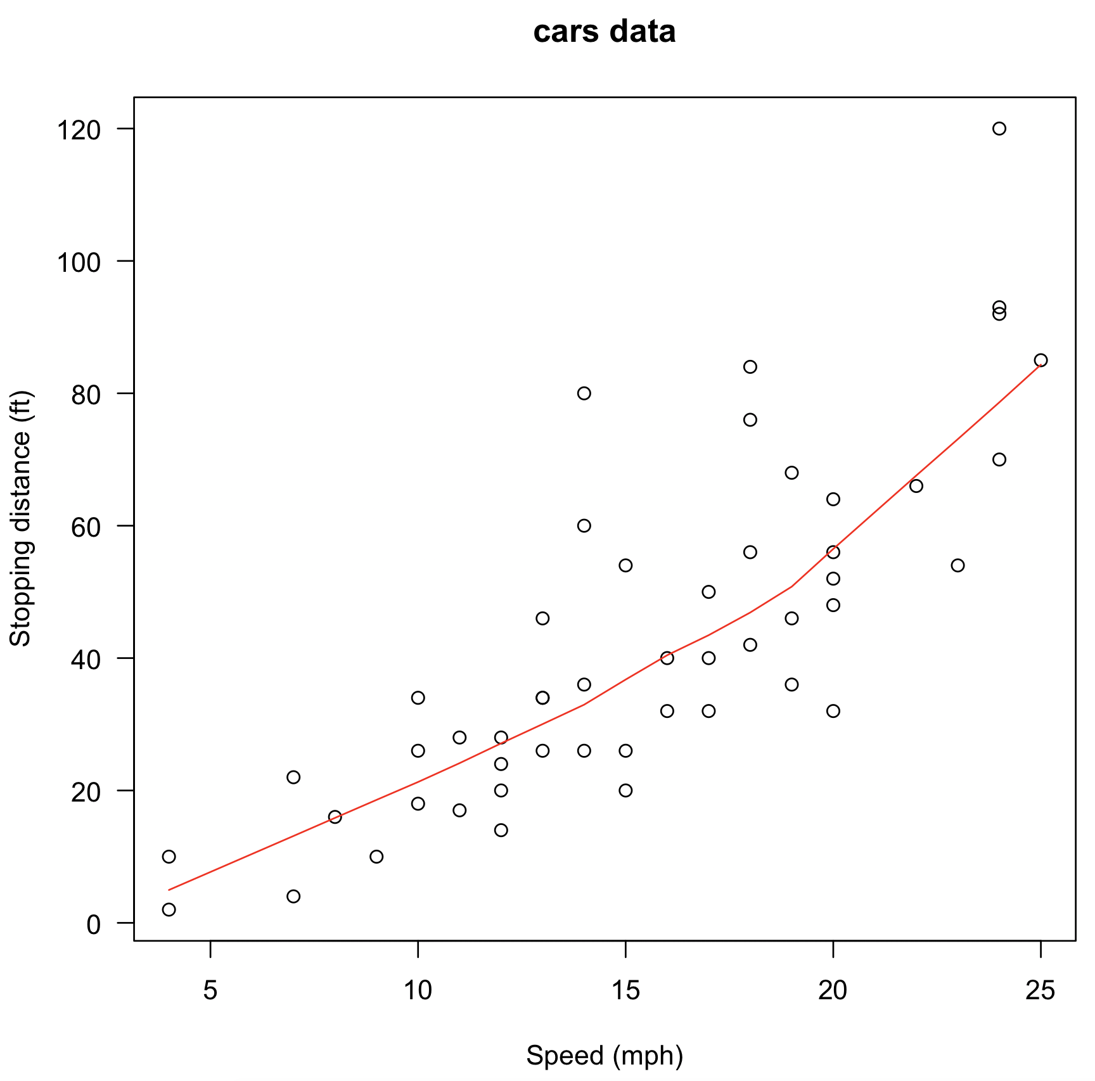
Supervised learning
Regression Example: Speed and Stopping Distances of Cars
The data (in R) give the speed of cars
and the distances taken to stop.
Note that the data were recorded in the 1920s.
Let’s take a look at this data in R.

Slide 17
Unsupervised Learning
Usually we want to:
Cluster or group people or items
Visually explore their characteristics
Estimate densities

Slide 18
Unsupervised Learning
Common techniques:
Dimension reduction
Principal Component Analysis (PCA)
Factor Analysis
Clustering
K-means algorithm
Hierarchical clustering,
Gaussian mixture models,
Hidden Markov Models

Slide 19
Unsupervised Learning
Example: Cluster curves

Slide 20
Unsupervised Learning
Example: Cluster curves

Slide 21
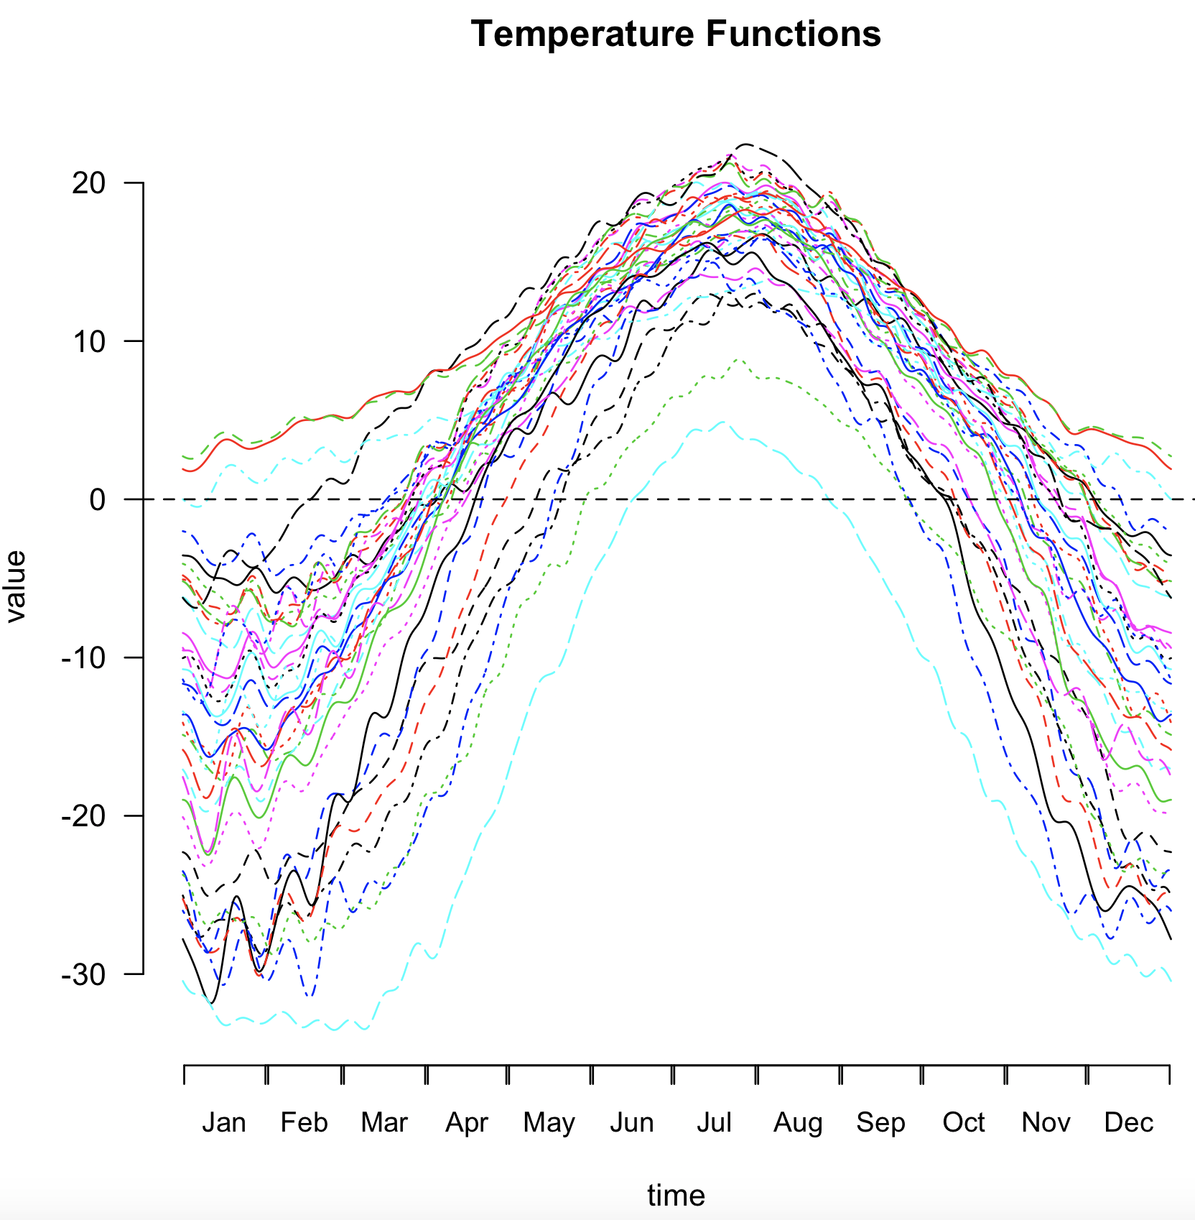
Unsupervised Learning
Let’s take a look at package fda in R

Slide 22
Unsupervised Learning
A list containing the heights of 39 boys and 54 girls
from age 1 to 18 and the ages at which they were collected.

Slide 23
Some interesting videos
https://www.youtube.com/watch?v=qDbpYUbf3e0
https://www.youtube.com/watch?v=hfO6iRj-GZo

Slide 24
Homework
1. Take this quiz: link – This is just to see how much of data science you know – Don’t worry if you don’t know the answers.
2. Readings:
A) Read this carefully: Data Science and Statistics
B) Read about the questions that come up in interviews: here
C) Take a look at this Berkeley description of Data Science: here
3. Explore Kaggle
https://www.kaggle.com/
If you have never visited this website, you should definitely spend some time there.
Choose a data set that you like. We may use it, analyze it during the next few of weeks

